Slide 1
Corporate Transparency Act Coffee Talk Overview of the CTA Requirements, Exemptions, Impact, and Best Practices
Presented by:
Tim Boone
Berliner Cohen LLP

Slide 2
Overview
The Corporate Transparency Act (CTA) is new federal legislation, effective January 1, 2024, promulgated in order to combat money laundering and terrorism financing through United States entities.
The CTA requires certain business entities to file Beneficial Ownership Information (BOI) and Reporting Company Information with the U.S. Department of the Treasury’s Financial Crimes Enforcement Network (FinCEN).
BOI will not be made public, but will be available to Federal, State, local, and trusted foreign agencies for law enforcement purposes.
Purpose: prevent the illegal use (“money laundering”) of anonymously owned entities
Notes:
See - William M. (Mac) Thornberry National Defense Authorization Act for Fiscal Year 2021 (Cite - 116 P.L. 283, 2021 Enacted H.R. 6395, 116 Enacted H.R. 6395, 134 Stat. 3388, Title LXIV) (Link - https://plus.lexis.com/api/permalink/b1315eed-4182-4fd9-9be7-d9bb3c38e599/?context=1530671)
Disclosure – BOI reported for the Corporate Transparency Act may not be disclosed by –
An officer or employee of the United States
An officer or employee of any State, local, or Tribal agency; or
An officer or employee of any financial institution or regulatory agency receiving information
FinCEN may disclose beneficial information reported pursuant to this section only upon receipt of –
A request through appropriate protocols –
From a Federal Agency engaged in national security, intelligence, or law enforcement activity, for use in furtherance of such activity; or
From a State, local, or Tribal law enforcement agency, if a court or competent jurisdiction, including any officer of such a court, has authorized the law enforcement agency to seek the information in a criminal or civil investigation;
A request from a Federal agency on behalf of a law enforcement agency, prosecutor, or judge of another country, including a foreign central authority or competent authority (or like designation), under an international treaty, agreement, convention, or official request made by law enforcement, judicial, or prosecutorial authorities in trusted foreign countries when no treaty, agreement, or convention is available

Slide 3
Is the CTA Constitutional?
National Small Business United v. Yellen, No. 5:22-cv-01448 (N.D. Ala.)
March 1, 2024 – District Court found the CTA unconstitutional. Declaratory relief applied ONLY to plaintiffs.
March 11, 2024 – Dept. of Treasury filed notice of appeal.
September 27, 2024 – 11th Circuit heard oral arguments in appeal.
Firestone v. Yellen, Docket No. 3:24-cv-01034 (D. Ore.)
September 20, 2024 – Plaintiffs’ request for a preliminary injunction denied.
BIG TAKEAWAY: Clients can’t wait for the courts to save them!

Slide 4
Who is Required to Report
Reporting Companies are required to report BOI and entity information to FinCEN.
“Reporting Companies” are either domestic or foreign entities that are:
A corporation,
A limited liability company, or
Any entity created (or a foreign entity registered in the US) by the filing of a document with a secretary of state or any similar office under the law of a state or Indian tribe.
It does not matter how long ago the entity was formed.
Generally, trusts are exempted from reporting.
23 categories of exempt entities.
Notes:
25% “ownership interest” is not limited to traditional equity (stock, membership interests, profits interests), but also applies broadly to any instruments (including debt) that are convertible into equity, as well as options, warrants, futures, puts, calls and other rights to buy or sell equity. Also applies to both non-voting as well as voting interests.
“Substantial Control” may exist, regardless of ownership interests, if the person:
Serves as a senior officer of the Reporting Company (President, CEO, COO, etc.);
Has authority over the appointment or removal of any senior officer or a majority of the board of directors (or similar body);
Directs, determines, or has substantial influence over important decisions made by the Reporting Company;
Has “any other form of substantial control” over the Reporting Company – an undefined “catch-all” criteria
“Beneficial Owners” does not include:
A minor child, defined in the State in which the entity is formed, if the info of the parent or guardian of the minor is reported in accordance with reporting requirements;
An individual acting as a nominee, intermediary, custodian, or agent on behalf of another individual;
An individual acting solely as an employee of a corp., LLC, or other similar entity and whose control over or economic benefits from such entity is derived solely from the employment status of the person;
An individual whose only interest in a corp., LLC, or other similar entity is through a right of inheritance; or
A creditor of a corp., LLC, or other similar entity, unless the creditor meets the reporting requirements

Slide 5
Major Exempted Entities
Entities already subject to federal regulatory regimes (e.g. banks, credit unions, insurance companies, investment companies, regulated public utilities, etc.).
Publicly-traded companies.
Tax-exempt entities (501(c) org., 527(e)(1) political org., or 4947(a) charitable trust).
Large operating companies:
> 20 full-time employees in the US;
In previous year, filed federal income tax > $5 million in gross receipts or sales from US sources; and
Operates physically at an office in the US.
Inactive entities that:
Were formed prior to January 1, 2020;
Have not engaged in any business activity;
Are not owned by a foreign person and have not had a change of control in the prior 12 months;
Have not sent or received funds in an amount greater than $1,000 in the prior 12 months; and
Hold no assets or interests in any other entity.
Notes:
“Reporting Company” does not include:
An issuer-
of a class of securities registered under section 12 of the Securities Exchange Act; or
that is required to file supplementary periodic information under section 15 of the Securities Exchange Act;
An entity-
established under the laws of the United States, an Indian Tribe, a State, or a political subdivision of a State, or under an interstate compact between 2 or more States; and
that exercises governmental authority on behalf of the United States or any such Indian Tribe, State, or political subdivision;
A bank (as defined in Federal Deposit Insurance Act, Investment Company Act of 1940, or Advisers Act of 1940);
A Federal or State credit union (as defined in the Federal Credit Union Act;
A bank holding company (as defined in the Bank Holding Company Act of 1956);
A money transmitting business registered with the Secretary of the Treasury (under 5330);
A broker or dealer (as defined in section 3 of the Securities Exchange Act of 1934 and registered under section 15 of that Act);
An exchange or clearing agency (as those terms are defined in section 3 of the Securities Exchange Act and registered under section 6 or 17A);
Any other entity non described previously that is registered with the Securities and Exchange Commission;
An entity that –
Is an investment company or an investment adviser (as defined in the Investment Company Act and Investment Advisers Act);
Is registered with the Securities and Exchange Commission under the Investment Company Act or the Investment Advisers Act;
An insurance company (as defined in section 2 of the Investment Company Act of 1940;
An entity that –
Is an insurance producer that is authorized by a State and subject to supervision by the insurance commissioner or a similar official or agency of a State; and
Has an operating presence at a physical office within the United States
A registered entity (as defined in section 1a of the Commodity Exchange Act; or
An entity that is –
A futures commission merchant, introducing broker, swap dealer, major swap participant, commodity pool operator, or commodity trading advisor (as those terms are defined in section 1a of the Commodity Exchange Act); or
A retail foreign exchange dealer (as described in section 2(c)(2)(B) of that Act); and
Registered with the Commodity Futures Trading Commission under the Commodity Exchange Act;
A public accounting firm registered in accordance with section 102 of the Sarbanes-Oxley Act of 2002;
A public utility that provides telecommunications services, electrical power, natural gas, or water and sewer services within U.S.;
A financial market utility designated by the Financial Stability Oversight Council under the Payment, Clearing, and Settlement Supervision Act;
Any pooled investment vehicle that is operated or advised by a person described in clause (iii), (iv), (x), or (xi);
Any –
Org. that is described in section 501(c) of the Internal Revenue Code and exempt from tax under section 501(a)
Political organization (as defined in section 527(e)(1) of such Code) that is exempt from tax under section 527(a) of such Code; or
Trust described in para. (1) or (2) of section 4947(a) of such Code;
Any corp., LLC, or other similar entity that –
Operates exclusively to provide assistance to, or hold governance rights over, any entity described in clause (xix);
Is a United States person;
Is a beneficially owned or controlled exclusively by 1 or more United States persons that are lawfully admitted for permanent residence; and
Derives at least a majority of its funding or revenue from 1 or more United States persons that are lawfully admitted for permanent residence;
Any corp., limited liability company, or other similar entity –
In existence for over 1 year;
That is not engaged in active business;
That is owned, directly or indirectly, by a foreign person;
That has not, in the preceding 12-month period, experienced a change in ownership or sent or received funds in an amount greater than $1,000 (including all funds sent to or received from any source through an account in which the entity maintains interest); and
That does not otherwise hold any kind or type of assets, including an ownership interest in any corp., LLC, or similar entity;

Slide 6
FinCEN List of Exempted 23 Entities
1. Securities reporting issuer
2. Governmental authority
3. Bank
4. Credit union
5. Depository institution holding company
6. Money services business
7. Broker or dealer in securities
8. Securities exchange or clearing agency
9. Other Exchange Act registered entity
10. Investment company or investment adviser
11. Venture capital fund adviser
12. Insurance company
13. State-licensed insurance producer
14. Commodity Exchange Act registered entity
15. Accounting firm
16. Public utility
17. Financial market utility
18. Pooled investment vehicle
19. Tax-exempt entity
20. Entity assisting a tax-exempt entity
21. Large operating company
22. Subsidiary of certain exempt entities
23. Inactive entity

Slide 7
Who are Beneficial Owners
“Beneficial Owner” – Reporting Companies must file information for any individual who:
Owns/controls ≥ 25% ownership interests; or
Exercises “substantial control” over the reporting company.
For purposes of LLCs and other entities issuing capital or profit interests (including entities treated as partnerships for federal income tax purposes), ownership interests are based on the individual's capital and profit interests in the entity…a right to receive 25% of distributions will trigger BOI, even if ownership is less.
Notes:
25% “ownership interest” is not limited to traditional equity (stock, membership interests, profits interests), but also applies broadly to any instruments (including debt) that are convertible into equity, as well as options, warrants, futures, puts, calls and other rights to buy or sell equity. Also applies to both non-voting as well as voting interests.
“Substantial Control” may exist, regardless of ownership interests, if the person:
Serves as a senior officer of the Reporting Company (President, CEO, COO, etc.);
Has authority over the appointment or removal of any senior officer or a majority of the board of directors (or similar body);
Directs, determines, or has substantial influence over important decisions made by the Reporting Company;
Has “any other form of substantial control” over the Reporting Company – an undefined “catch-all” criteria
“Beneficial Owners” does not include:
A minor child, defined in the State in which the entity is formed, if the info of the parent or guardian of the minor is reported in accordance with reporting requirements;
An individual acting as a nominee, intermediary, custodian, or agent on behalf of another individual;
An individual acting solely as an employee of a corp., LLC, or other similar entity and whose control over or economic benefits from such entity is derived solely from the employment status of the person;
An individual whose only interest in a corp., LLC, or other similar entity is through a right of inheritance; or
A creditor of a corp., LLC, or other similar entity, unless the creditor meets the reporting requirements

Slide 8
Ownership Interest
Very broad:
• Stock
• Capital or profits interest (“units”) in an LLC or partnership
• Any convertible instrument (i.e, convertible debt, SAFEs)
No exceptions for future/contingent conversion rights
• Any puts, calls, options, warrants
• Anything else used to establish ownership
Notes:
25% “ownership interest” is not limited to traditional equity (stock, membership interests, profits interests), but also applies broadly to any instruments (including debt) that are convertible into equity, as well as options, warrants, futures, puts, calls and other rights to buy or sell equity. Also applies to both non-voting as well as voting interests.
“Substantial Control” may exist, regardless of ownership interests, if the person:
Serves as a senior officer of the Reporting Company (President, CEO, COO, etc.);
Has authority over the appointment or removal of any senior officer or a majority of the board of directors (or similar body);
Directs, determines, or has substantial influence over important decisions made by the Reporting Company;
Has “any other form of substantial control” over the Reporting Company – an undefined “catch-all” criteria
“Beneficial Owners” does not include:
A minor child, defined in the State in which the entity is formed, if the info of the parent or guardian of the minor is reported in accordance with reporting requirements;
An individual acting as a nominee, intermediary, custodian, or agent on behalf of another individual;
An individual acting solely as an employee of a corp., LLC, or other similar entity and whose control over or economic benefits from such entity is derived solely from the employment status of the person;
An individual whose only interest in a corp., LLC, or other similar entity is through a right of inheritance; or
A creditor of a corp., LLC, or other similar entity, unless the creditor meets the reporting requirements

Slide 9
Substantial Control
Those with “Substantial Control” include
senior officers;
those with authority to appoint or remove certain officers or a majority of directors
“Important decision-makers”;
Those with any other form of substantial control over the reporting company
Intends to capture anyone who is able to make important decisions on behalf of the entity.
This excludes employees whose economic benefits are derived solely from employment, but it does not exclude “senior officers”
Notes:
25% “ownership interest” is not limited to traditional equity (stock, membership interests, profits interests), but also applies broadly to any instruments (including debt) that are convertible into equity, as well as options, warrants, futures, puts, calls and other rights to buy or sell equity. Also applies to both non-voting as well as voting interests.
“Substantial Control” may exist, regardless of ownership interests, if the person:
Serves as a senior officer of the Reporting Company (President, CEO, COO, etc.);
Has authority over the appointment or removal of any senior officer or a majority of the board of directors (or similar body);
Directs, determines, or has substantial influence over important decisions made by the Reporting Company;
Has “any other form of substantial control” over the Reporting Company – an undefined “catch-all” criteria
“Beneficial Owners” does not include:
A minor child, defined in the State in which the entity is formed, if the info of the parent or guardian of the minor is reported in accordance with reporting requirements;
An individual acting as a nominee, intermediary, custodian, or agent on behalf of another individual;
An individual acting solely as an employee of a corp., LLC, or other similar entity and whose control over or economic benefits from such entity is derived solely from the employment status of the person;
An individual whose only interest in a corp., LLC, or other similar entity is through a right of inheritance; or
A creditor of a corp., LLC, or other similar entity, unless the creditor meets the reporting requirements

Slide 10
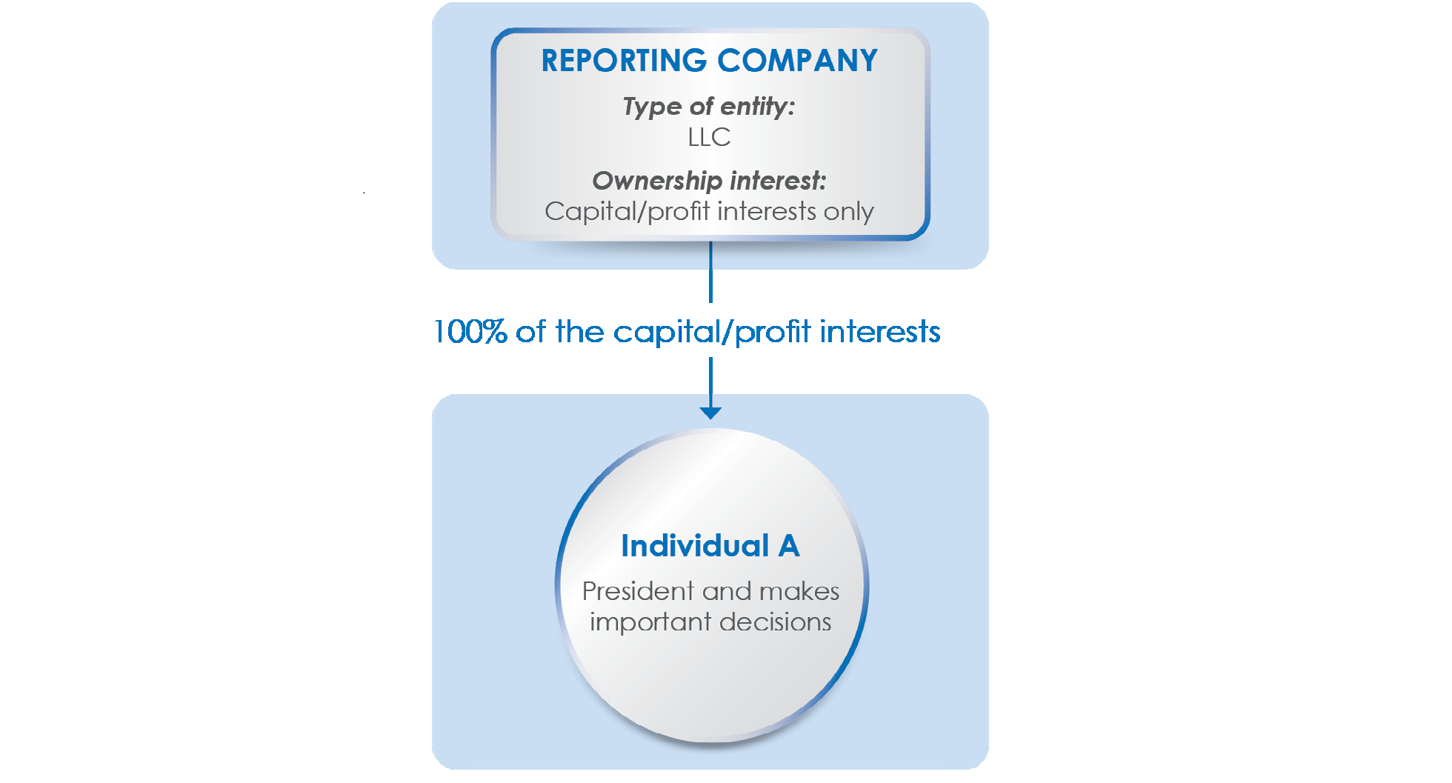
Reporting: “A” 25%+ BOI and as Officer and for substantial control

Slide 11
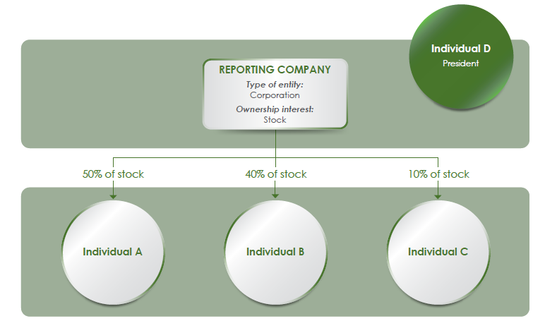
Reporting: “A” 25%+ BOI, “B” as 25%+ BOI, and “D” as Officer

Slide 12
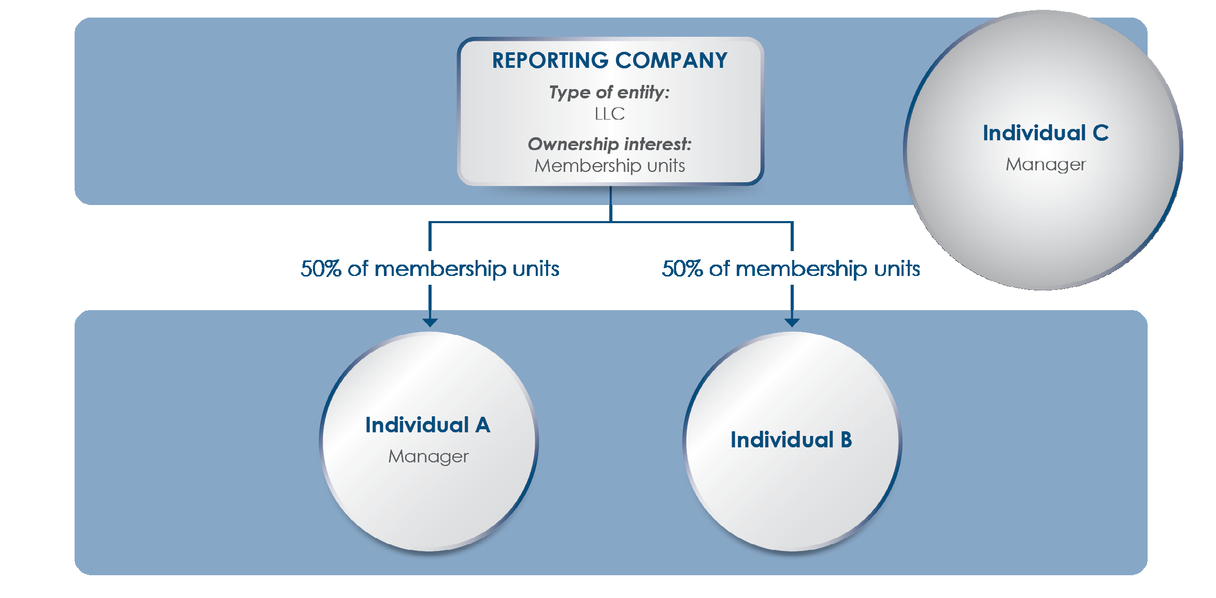
Reporting: “A” 25%+ BOI and as Manager, “B” as 25%+ BOI, and “C” as Manager

Slide 13
Reporting: “A” as Officer and indirect 25%+ BOI (27.5%), “B” as indirect 25%+ BOI (35%), “C” as Officer, “F” for substantial control.

Slide 14
Who are Company Applicants
“Applicant” – Reporting Companies must file information for the individual who:
Directly files the document that first forms / registers the entity; or
Is primarily responsible for directing or controlling the filing of the relevant document by another.
Applicants of preexisting entities are exempted.
A Reporting Company may not have more than two (2) Applicants.
Notes:
25% “ownership interest” is not limited to traditional equity (stock, membership interests, profits interests), but also applies broadly to any instruments (including debt) that are convertible into equity, as well as options, warrants, futures, puts, calls and other rights to buy or sell equity. Also applies to both non-voting as well as voting interests.
“Substantial Control” may exist, regardless of ownership interests, if the person:
Serves as a senior officer of the Reporting Company (President, CEO, COO, etc.);
Has authority over the appointment or removal of any senior officer or a majority of the board of directors (or similar body);
Directs, determines, or has substantial influence over important decisions made by the Reporting Company;
Has “any other form of substantial control” over the Reporting Company – an undefined “catch-all” criteria
“Beneficial Owners” does not include:
A minor child, defined in the State in which the entity is formed, if the info of the parent or guardian of the minor is reported in accordance with reporting requirements;
An individual acting as a nominee, intermediary, custodian, or agent on behalf of another individual;
An individual acting solely as an employee of a corp., LLC, or other similar entity and whose control over or economic benefits from such entity is derived solely from the employment status of the person;
An individual whose only interest in a corp., LLC, or other similar entity is through a right of inheritance; or
A creditor of a corp., LLC, or other similar entity, unless the creditor meets the reporting requirements

Slide 15
Reporting Requirements
Reporting Companies must report:
Full legal name & any trade name;
Principal place of business address;
Jurisdiction of formation / registration; and
Tax Identification Number.*
Required Applicant/Beneficial Owners Information:
Full Legal Name;
Date of Birth;
Current Residential Address; and
Non-Expired U.S. Identification Document, or a Foreign Passport (requires an image of the identification document).
FinCEN rejected the proposed collection of an individual’s TIN.
Notes:
Acceptable Identification means:
(A) a nonexpired passport issued by the United States;
(B) a nonexpired identification document issued by a State, local government, or Indian Tribe to the individual acting for the purpose of identification of that individual;
(C) a nonexpired driver’s license issued by a State; or
(D) if the individual does not have a document described in subparagraph (A), (B), or (C), a nonexpired passport issued by a foreign government

Slide 16
Phase-in of Reporting Requirements
All new Reporting Companies – those formed or registered after January 1, 2024 – must report BOI for both their Beneficial Owners and Company Applicants to FinCEN within 90 days after formation or registration (measured from date of actual notice). After 2024, within 30 days after formation or registration.
All existing Reporting Companies – those formed or registered before January 1,2024 – must report BOI for their Beneficial Owners (but not their Company Applicants) to FinCEN no later than January 1, 2025.
Updates – If there are any changes in the identities of Beneficial Owners or to any of their BOI (including change of address, passport numbers, etc.), a Reporting Company must file an updated report with FinCEN within 30 days of the change - regardless of when the Reporting Company learns of it.
Reports will be submitted electronically using FinCEN’s online system titled “Beneficial Ownership Secure System (BOSS)”.
Notes:
See Sec. 6403. Beneficial Ownership Information Reporting Requirements

Slide 17
FinCEN Identifiers
FinCEN will allow Reporting Company, BOI or Applicant to obtain a numerical “FinCEN Identifier” which may be supplied in lieu of detailed info.
He/she will also be responsible for any updates to the BOI.
Reporting Companies will also be able to obtain their own FinCEN Identifiers.
e.g., if a person is a Beneficial Owner of several Reporting Companies, each of those companies will only have to report that person’s FinCEN Identifier.

Slide 18
Use of BOI information
The information collected pursuant to this filing is collected on a secure, nonpublic database, and is generally not available for government employees to disclose. The information is not subject to the Freedom Of Information Act
Those who may access include:
Federal agencies engaged in national security, intelligence, and civil and criminal law enforcement
State, local, and tribal law enforcement agencies if “a court of competent jurisdiction” rules that those agencies should be allowed access to that information.
“Trusted” foreign law enforcement via intermediary U.S. federal agencies
The Department of the Treasury in connection with its official duties, including tax administration
Financial institutions in order to meet customer due diligence requirements under applicable law and only if the Reporting Company consents to the search.
Notes:
Safe Harbor – a person shall not be subject to civil or criminal penalty if the person –
Has reason to believe that any report submitted by the person contains inaccurate information; and
In accordance with regulations issued by the Secretary, voluntarily and promptly, and in no case later than 90 days after the date on which the person submitted the report, submits a report containing corrected information.
Exceptions – a person shall not be exempt from penalty under clause (i) if, at the time the person submits the report required by subsection (b), the person –
Acts for the purpose of evading the reporting requirements; and
Has actual knowledge that any information contained in the report is inaccurate.
* FinCEN shall provide assistance to any person seeking to submit a corrected report.

Slide 19
Penalties for Failure to Report
Unlawful for any person to willfully provide false or fraudulent BOI or willfully fail to report complete / update BOI.
FinCEN will consider all facts relevant to a determination of willfulness when deciding whether to pursue enforcement actions.
Civil Reporting Penalties:
$500 per day for each day of outstanding violation up to $10,000.
Criminal Penalties:
Maximum 2 years imprisonment.
No penalties for negligent reporting.
Safe Harbor – No penalties in the event an individual who provides inaccurate information:
Did not know about the inaccuracy;
Were not attempting to evade reporting requirements;
Corrects inaccurate information “voluntarily and promptly,” but no more than 90 days after submission.
Misuse of BOI can result in criminal fines up to $250,000 and 5 years imprisonment.
Senior officers of an entity that fails to file a required BOI report may be held accountable for that failure
Notes:
Safe Harbor – a person shall not be subject to civil or criminal penalty if the person –
Has reason to believe that any report submitted by the person contains inaccurate information; and
In accordance with regulations issued by the Secretary, voluntarily and promptly, and in no case later than 90 days after the date on which the person submitted the report, submits a report containing corrected information.
Exceptions – a person shall not be exempt from penalty under clause (i) if, at the time the person submits the report required by subsection (b), the person –
Acts for the purpose of evading the reporting requirements; and
Has actual knowledge that any information contained in the report is inaccurate.
* FinCEN shall provide assistance to any person seeking to submit a corrected report.

Slide 20
CTA Filing Best Practices
Don’t file Articles of Organization/Incorporation until all CTA information has been obtained in writing via questionnaire OR until client has confirmed in writing that you will not be responsible for CTA filings.
Any entity formation questionnaire should explicitly obtain the client’s consent to transmit required CTA information to FinCEN. The entity questionnaire should be signed by the client as to such consent and the accuracy of the information.
Calendar CTA deadlines.
Send post-formation letters that include CTA compliance information and explicitly states it is the client’s obligation to notify you of future events that would trigger subsequent CTA filings.
If you are going to be an Applicant, obtain a FinCEN identification number first.

Slide 21
Lessons in BOI Reporting
Be proactive about obtaining required BOI.
FinCEN is focused on willful non-compliance. Keep this in mind when dealing with uncooperative beneficial owners.
Consider operating agreement or shareholder agreement updates to address beneficial owner non-compliance.
What if a beneficial owner does not have required identification documentation?

Slide 22
Resources
BOI FAQ: https://fincen.gov/boi-faqs
Small Entity Compliance Guide: https://fincen.gov/boi/small-entity-compliance-guide
FinCEN Reference Materials: https://fincen.gov/boi/Reference-materials

Slide 23
Questions?

Slide 24
Tim Boone
Email: Timothy.Boone@berliner.com
Phone: (209) 576-0111
Practices:
Real Estate, Tax Law, Corporate Law, Estate Planning
About Berliner Cohen, LLP
Berliner Cohen serves the business and regulatory needs of private businesses and public agencies. For over 50 years, the firm has developed the special expertise required by a diverse client base consisting of some of Northern California’s most influential and largest corporations, new ventures, leading real estate developers, cutting-edge technology companies, municipalities and public agencies, healthcare providers, and mortgage banking companies. Berliner Cohen attorneys concentrate on providing experienced, knowledgeable and innovative solutions and services for our clients in numerous practice areas, including:
Business Litigation
Corporate and Tax
Employment
Hospitality
Estate Planning
Real Estate Litigation and Contract Negotiation
Land Use Planning and Development
Tim’s practice areas include complex real estate and business transactions, business formation, estate planning, and trust and estate administration. He has counseled clients in the negotiation and drafting of leases, easements, 1031 exchanges, the purchase and sale of real estate and business interests, business formation, and business and estate succession.
Prior to joining Berliner Cohen, Tim served as Vice President of Legal Services for Crescendo Interactive, a renowned leader in the field of charitable planning. While at Crescendo, he assisted nonprofit fundraisers, financial advisors, and attorneys in creating advanced estate and charitable plans.
Tim is a fourth-generation resident of Modesto and Stanislaus County and the proud grandson of a retired peach and almond farmer. He is also honored to give back to his community as a board member for the Stanislaus County Education Foundation, the Stanislaus County Estate Planning Council, and Modesto Sunrise Rotary.

